Slide 1
Silverlight 4 – A Guided Tour of MEF
Mike Taulty, Microsoft UK
mtaulty@microsoft.com
mtaulty.com
@mtaulty

Slide 2
MEF – What is it? How and when do I get it?
the Managed Extensibility Framework
an extensible framework for composing applications from a set of loosely-coupled parts discovered and evolving at run-time
versions
.NET Framework shipping with Silverlight 4
.NET Framework 4 shipping with VS 2010
CodePlex version for Silverlight 3, .NET 3.5 Sp1

Slide 3
“scenario”
MediaPlayer
Constructor()
IAlbumInfoProvider
GetAlbumInfo(“Blood on the Tracks”)
AlbumInfoProvider
Constructor()
GetAlbumArt(“Blood on the Tracks”)
IAlbumArtProvider
AlbumArtProvider

Slide 4
using MEF in our scenario

Slide 5
MEF models composable parts
import
import
import
Part
export
export

Slide 6
MEF composes parts
import
import
part
import
import
part
import
export
import
import
part
import
export
part
import
export
export
Compose
Composition Engine
part
part
part
part
part

Slide 7
which parts compose together?
import
import
import
part
export
export
?
Contract
Name
Shared
Metadata
import
part
Contract
Name
Cardinality
Shared
Recomposable
Metadata

Slide 8
matching imports to exports

Slide 9
parts & part definitions
import
import
import
import
Part
PartDefinition
export
export
export
CreatePart()
PartDefinition is a blueprint for a Part
similar to Object and Type in .NET
but can have Part without PartDefinition

Slide 10
container draws parts from catalogs
import
import
Part
import
import
export
import
export
Part
import
PartDefinition
PartDefinition
PartDefinition
PartDefinition
PartDefinition
PartDefinition
export
export
PartDefinition
PartDefinition
PartDefinition
PartDefinition
PartDefinition
PartDefinition
Catalog
Catalog
Catalog
Catalog
import
CompositionContainer
import
Part
import
export
export

Slide 11
or mix in pre-instantiated parts
part
Imports(“Foo”)
Compose()
part
Exports(“Foo”)
CompositionContainer

Slide 12
the built-in catalogs* (* one is missing, we’ll come back to it later )

Slide 13
things change - recomposition
New parts [introduced to/removed from] container may have an impact on this import – a part can opt-in to allow this recomposition
part
Compose()
part?
part
CompositionContainer
part
Catalog
Catalog
Catalog
PartDefinition
PartDefinition
PartDefinition
PartDefinition
Some catalogs support additions

Slide 14
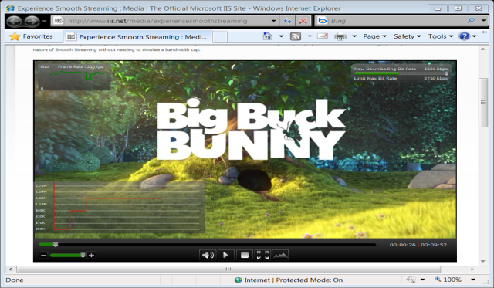
recomposition is key for Silverlight
MyApp.xap
initial, small download
additional functionality
Extras.xap

Slide 15
recomposition & DeploymentCatalog ( completing our story of built-in catalogs )

Slide 16
stable composition
reject parts with unsatisfied imports
reject changes that break “agreements”
part
part
requires exactly
one part
requires
part
part
requires
different part,
same contract
CompositionContainer
missing
part

Slide 17
stable composition

Slide 18
MEF and Model View ViewModel
Strong separation of concerns possible with Silverlight development
user interface declared in XAML
loosely binds to data
functionality invoked by declarative commands
Encapsulated by the “MVVM” pattern
binding
view
(declarative XAML)
viewmodel
(state & data for view)
model
(“data”)
commands

Slide 19
MEF and MVVM

Slide 20
Pointers to more advanced topics

Slide 21
part ownership
Imports(“Foo”)
part
part definition
part
Disposable
Exports(“Bar”)
Compose()
catalog
Imports(“Bar”)
part
references
Shared
Exports(“Foo”)
CompositionContainer
part
owns
container only owns parts it created
will Dispose those parts when it is Disposed
container references some parts
needs those marked shared or recomposable

Slide 22
extensibility – catalogs & export providers
Catalog
CatalogExportProvider
CompositionContainer
ComposablePartCatalog
ExportProvider
...
ExportProvider
CatalogExportProvider
AggregateExportProvider
ExportProvider
ExportProvider
ExportProvider
CompositionContainer

Slide 23
extensibility – programming models
MEF Primitives
Programming models in MEF are pluggable
[Attribute] is the built-in model
Custom models involve implementing some/all of MEF’s primitive classes
ComposablePartCatalog
ComposablePartDefinition
ComposablePart
ExportDefinition
ImportDefinition

Slide 24
resources
Channel 9 Silverlight 4 MEF Screencasts
channel9.msdn.com/tags/learnMEFSL4
Glenn Block
blogs.msdn.com/gblock
Nicholas Blumhardt
blogs.msdn.com/nblumhardt
MEF on CodePlex
mef.codeplex.com

Slide 25
thank you ☺
© 2010 Microsoft Corporation. All rights reserved. Microsoft, Windows, Windows Vista and other product names are or may be registered trademarks and/or trademarks in the U.S. and/or other countries.
The information herein is for informational purposes only and represents the current view of Microsoft Corporation as of the date of this presentation. Because Microsoft must respond to changing market conditions, it should not be interpreted to be a commitment on the part of Microsoft, and Microsoft cannot guarantee the accuracy of any information provided after the date of this presentation.
MICROSOFT MAKES NO WARRANTIES, EXPRESS, IMPLIED OR STATUTORY, AS TO THE INFORMATION IN THIS PRESENTATION.

Slide 26
Silverlight 4 – A Guided Tour of MEF
Mike Taulty, Microsoft UK
mtaulty@microsoft.com
mtaulty.com
@mtaulty

